Slide 1
Handwriting Analysis using Graphology
Team Members Tag: SECURITY
Project Advisor: Ms. P. Malathi
(Assistant Professor – CSE)
S.No | Reg.No | Name of the Student | Section
1 | CB.EN.U4CSE19012 | B. SAI GAYATHRI REDDY | CSE A
2 | CB.EN.U4CSE19015 | E. SAHITYA | CSE A
3 | CB.EN.U4CSE19019 | G.L.SRESHTA | CSE A
4 | CB.EN.U4CSE19623 | J.SAI RUPA | CSE F

Slide 2

Screen shot of Mail approval from guide

Slide 3
Problem definition
Handwriting Analysis Using Graphology and Machine Learning.

Slide 4
Literature survey (Existing system)
S.no | Authors Name(s) | Full title of the paper with year | Inference from the paper ( based on methodology, technology ) | Open Problem ( for proposed work )
1. | Abhar, Iran, Abhar Branch, Islamic Azad University | Graphology for Farsi Handwriting Using Image Processing Techniques - 2015 | Decisions about the personality can be taken based on the rules defined and features acquired by using SVM classifier called Maximum Margin Classifiers | CNN , Deep Learning
2. | Rushikesh M Sutar , Pravin S Revankar | Analysis of Character Strengths from Handwriting Samples using Deep Learning- | CNN,artificial neural model used to take inputs and learn weights of each hidden layer neuron through the use of backpropagation learning. | Morphological Segmentation

Slide 5
S.no | Authors Name(s) | Full title of the paper with year | Inference from the paper ( based on methodology, technology ) | Open Problem ( for proposed work )
3. | Lakshmi Durga, Deepu R | Handwriting Analysis Through Graphology: A Review-2015 | different analysis methods used are Rule-Based system, Back propagation neural network, ANN, Simple Linear Regression method, Support Vector Machine, Multi-Structure algorithm and Artificial Neural networks. | Morphological Segmentation
4. | Rony Cohen, Batia Cohen-Kroitoru, Ayelet Halevy, Sharon Aharoni, Irena Aizenberg & Avinoam Shuper | Handwriting in children with Attention Deficient Hyperactive Disorder: role of graphology | In each sample, 1 point was accorded for every abnormal characteristic identified, yielding a graphology score ranging from 0 to 15. Patients with a score of 9 or more were considered to have ADHD. | It is likely that handwriting problems in ADHD have less to do with the writing itself and more to do with factors related to motor control.

Slide 6
S.no | Authors Name(s) | Full title of the paper with year | Inference from the paper ( based on methodology, technology ) | Open Problem ( for proposed work )
5. | Anamika Sen,Harsh Shah | topic name:Automated handwriting analysis system using principles of graphology and image processing | This paper implements an automated Handwriting Analysis System which extracts 6 different handwriting features using Image Processing. Based on these features, the corresponding personality trait is displayed. | A further scope in this work can be done by using Artificial Neural Networks or Machine Learning Approach or Fuzzy Logic.
6. | Najla AL-Qawasmeh , Muna Khayyat, Ching Y. Suen | Novel features to detect gender from handwritten documents | In this paper, a set of gender-related features suggested by a graphologist, to detect the gender of the writers, have been proposed which used Both SVM and ANN classifiers have been used to train, validate and test the proposed approach on two different data sets. | In this paper it is not identifying the personality traits of the writer, which we are doing.

Slide 7
S.no | Authors Name(s) | Full title of the paper with year | Inference from the paper ( based on methodology, technology ) | Open Problem ( for proposed work )
7. | Prajakta Mahale, Vinaya Kumbhar, Mayuri Deshmukh, Prof. Y. R. Dhumal | Handwriting Analysis Using Machine Learning | Here the input from the user is pre-processed and passed into the CNN. It analyses the input image input by CNN model and gives he percentage of various types of traits present in the handwriting sample of the subject | In this paper they only few variables into consideration and used only CNN. Where as we are using the OCR model and doing the morphological segmentation.
8. | Gyanendra Chaubey and Siddhartha Kumar Arjaria | Personality Prediction Through Handwriting Analysis Using Convolutional Neural Networks | In this, we are going to use the Convolutional Neural Network (CNN) to predict five big personality traits (Agreeableness, Conscientiousness, Extraversion, Neuroticism, Openness) of the writer at the time of writing. | In this paper they identified only 5 big personality traits and trained the model. Where as we are using the OCR model and doing the morphological segmentation before training the model.

Slide 8
Justification for the proposed problem
Motivation and Need
Handwriting analysts also known as graphologists can examine an individual’s handwriting to predict the personality traits of the writer. Automated handwriting analysis can be used to examine personal traits of candidates accurately as the accuracy of an analyst highly depends on his skill set. Also hiring a graphologist to analyze hundreds of samples will be time consuming and not be feasible economically.

Slide 9
Software/Tools Requirements
MATLAB : MATLAB (matrix laboratory) is a multi-paradigm numerical computing environment and proprietary programming language developed by MathWorks.
Image Pre-Processing Toolbox : A MATLAB toolbox used for Image Pre-Processing.
Deep Learning Toolbox : A MATLAB toolbox used for implementing Deep Learning algorithms.

Slide 10
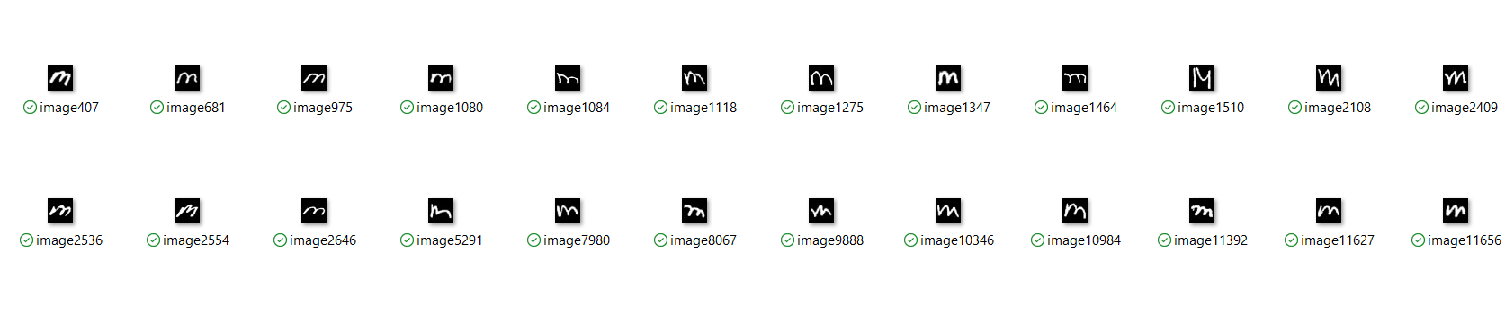
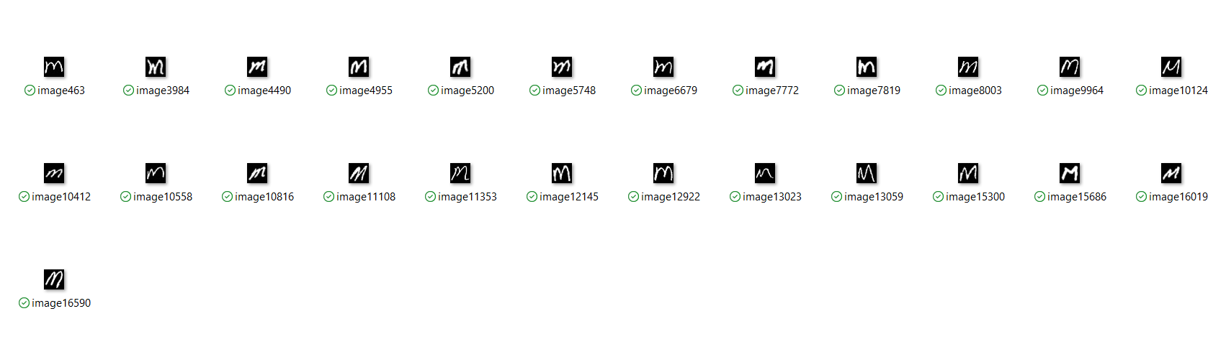
Data Set
Sample data set :

Slide 11
Work Plan
Pre processing
Image Acquisition
Resizing
Improved Morphology - ROI Segmentation
Color Conversion
Classification using Googlenet -CNN
Convolution layer
reluLayer
Pooling Layer
fullyConnectedLayer
dropoutLayer
Extract Features by Repeated line tracking method
Classification using Transfer Learning
Finger print Image
Yes
Display Result
If Authenticated
No
Result will not displayed

Slide 12
MODULES
IMAGE ACCUSATION.
PRE-PROCESSING.
IMPROVE MORPHOLOGY – ROI SEGMENTATION.
CLASSIFICATION.
AUTHENTICATION.

Slide 13
Modules and its explanation
Image Acquisition:
Image Acquisition is a process of getting an input image for the process of automatic detection of handwritten text using Digital Image Processing.
Pre processing:
Pre-processing is a common name for operations with images at the lowest level of abstraction both input and output are intensity images. The aim of pre-ο.processing is an improvement of the image data that suppresses unwanted distortions or enhances some image features important for further processing.

Slide 14
ROI Segmentation:
Image segmentation is the process of partitioning a digital image into multiple segments and is the first step of image analysis.
The goal of segmentation is to simplify and/or change the representation of an image into something that is more meaningful and easier to analyze.
Image segmentation is typically used to locate objects and boundaries in images.
The result of image segmentation is a set of segments that collectively cover the entire image, or a set of contours extracted from the image.
The image segmentation can be classified into two basic types: Local segmentation and Global segmentation.

Slide 15
Improved Morphological Segmentation :
After the preprocessing, segmentation will be done to broke the images into sub images containing individual characters. Erosion and Dilation are morphological image processing operations. Morphological image processing basically deals with modifying geometric structures in the image.
Erosion basically strips out the outermost layer of pixels in a structure, where as dilation adds an extra layer of pixels on a structure.
After that, we need to create a bounding box for each character of the word it means where ever pixel values are 1 it will create rectangle bounding box.
Bounding box is merely the coordinates of the rectangular border that fully encloses a digital image when it is placed over a page, a canvas, a screen or other similar bidimensional background.
To facilitate this, all finite shapes defined by planar have a bounding_box attribute which returns the smallest Bounding Box object that completely contains the shape.

Slide 16
Classification:
Image classification analyzes the numerical properties of various image features and organizes data into categories.
Classification algorithms typically employ two phases of processing: training and testing.
In the initial training phase, characteristic properties of typical image features are isolated and, based on these, a unique description of each classification category training class, is created.
In the subsequent testing phase, these feature-space partitions are used to classify image features.
Convolutional Neural Networks:
Recognition of handwritten digits was one of the first application where CNN architecture was successfully implemented.
Convolutional Neural Networks are mostly used in the ImageNet Challenge with various combinations of datasets of sketches.

Slide 17
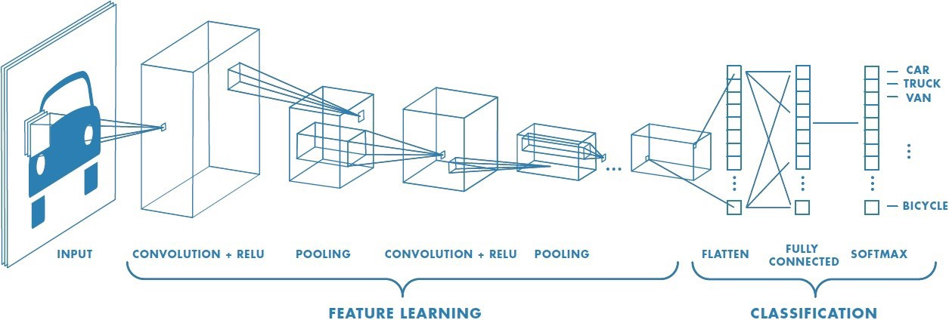
convolution neural network has multiple hidden layers that help in extracting information from an image. The four important steps in CNN are:

Slide 18
Input Layer: The input layer of the architecture takes the input from the dataset.
Convolution Layer: Convolution layer performs the convolution operation on the image to extract the features from the image. A weighted matrix is formed using the input image and the kernel
Pooling Layer:Using the features obtained after convolution for classification, the pooling layer takes small rectangular blocks from the convolutional layer and subsamples it to produce a single output from that block.
Flatten Layer: This layer transforms a two-dimensional feature matrix into a vector that can be fed into a fully connected neural network layer.
Fully Connected Layer: The final layer is the fully connected layers which takes the high-level filtered images and translate them into categories with labels.
Soft max : softmax operations are useful to scale model outputs into probabilities.

Slide 19
Steps involved in proposed method
Creating training and testing dataset , super classes images used for training is resized pixels for AlexNet and pixels GoogLeNet and ResNet50, dataset is divided into
training and validation data sets.
Modifying CNNs network - Set the final fully connected layer to have the same size as the number of classes in the training data set. Increase the learning rate factors of the fully connected layer to train network faster.
Set the training options, including learning rate, mini-batch size, and validation data according to GPU specification of the system. Train the network using the training data.
Test the accuracy of the network by Classifing the validation images using the fine-tuned network, and calculate the classification accuracy

Slide 20
Finger print Recognition:
1. Feature extraction
The process of minutiae extraction is done as the last step in feature extraction and then the final image is stored in database.
Operating upon the thinned image the minutiae are straightforward to detect the endings are found at the termination points of thin lines.
Bifurcations are found at the junctions of three lines. Feature attributes are determined for each valid minutia found. These consist of: ridge ending, the (x,y) location, and the direction of the ending bifurcation.

Slide 21
2. Repeated Line Tracking:
Repeated line tracking method gives a promising result in finger-vein identification.
Line tracking starts randomly at different positions. To find the dark line line tracking executed by moves along the direction of vein pattern pixel by pixel.
The idea is to trace the veins in the image by chosen directions according to predefined probability in the horizontal and vertical orientations, and the starting position, called seed is randomly selected; the whole process is repeatedly done for a certain number of times.

Slide 22
Steps involve in Feature extraction using repeated line tracking:
Step 1: Determination of the starting point for line tracking and the moving-direction attributes.
Step 2: Detection of the direction of the dark line and movement of the tracking point
Step 3: Updating the number of times points in the locus space have been tracked
Step 4: Repeated execution of step 1 to step 3 (N times)
Step 5: Acquisition of the finger-vein pattern from the locus space
Advantages of repeated line tracking:
Reduce the computation time: Repeated line tracking reduce unnecessary tracking operations which result in faster processing and reduce the computation time.
Reduce size of pattern: Repeated line tracking reduces the size of locus space result in fast response as smaller the template, the faster the computation

Slide 23
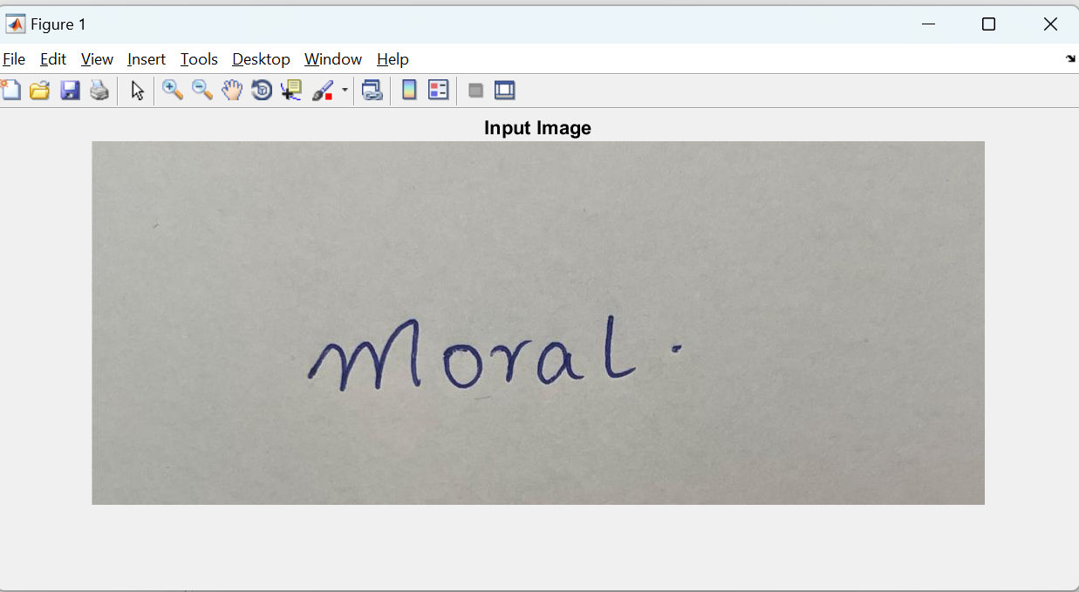
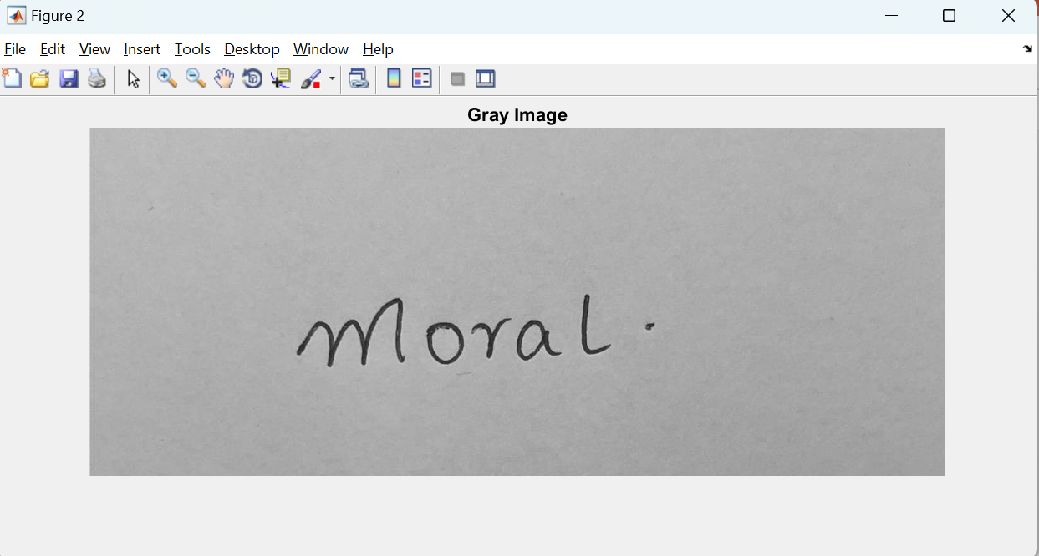
OUTPUT AND RESULTS

Slide 24
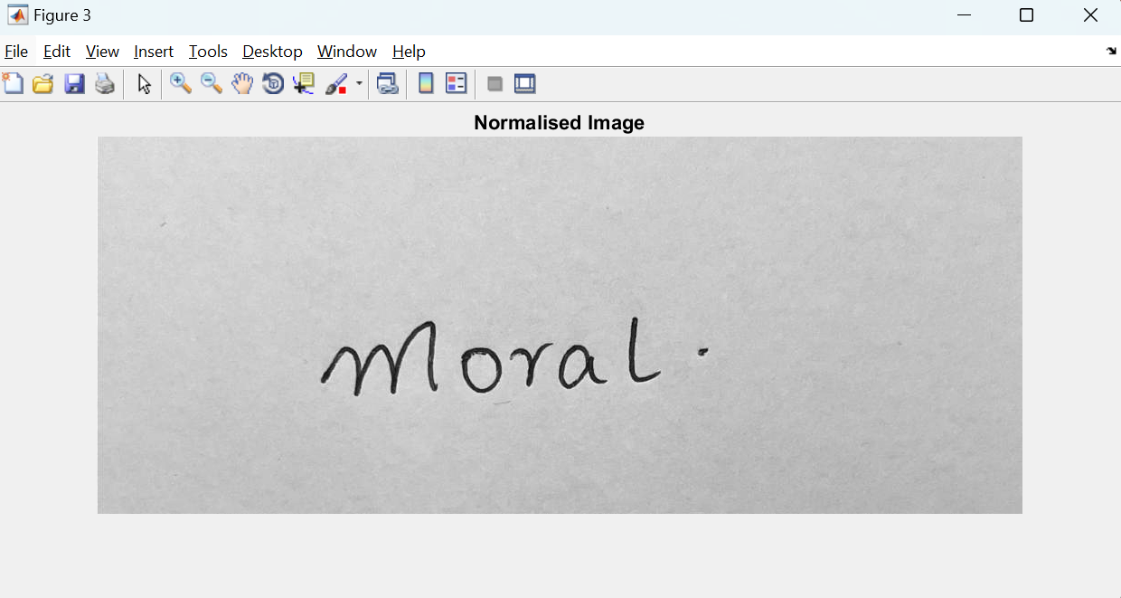
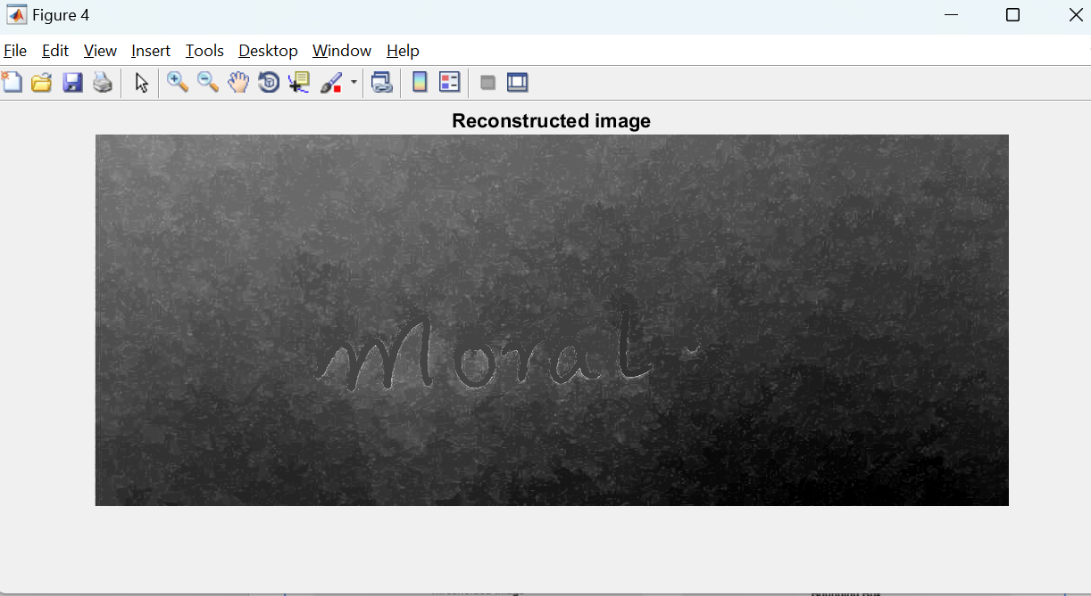
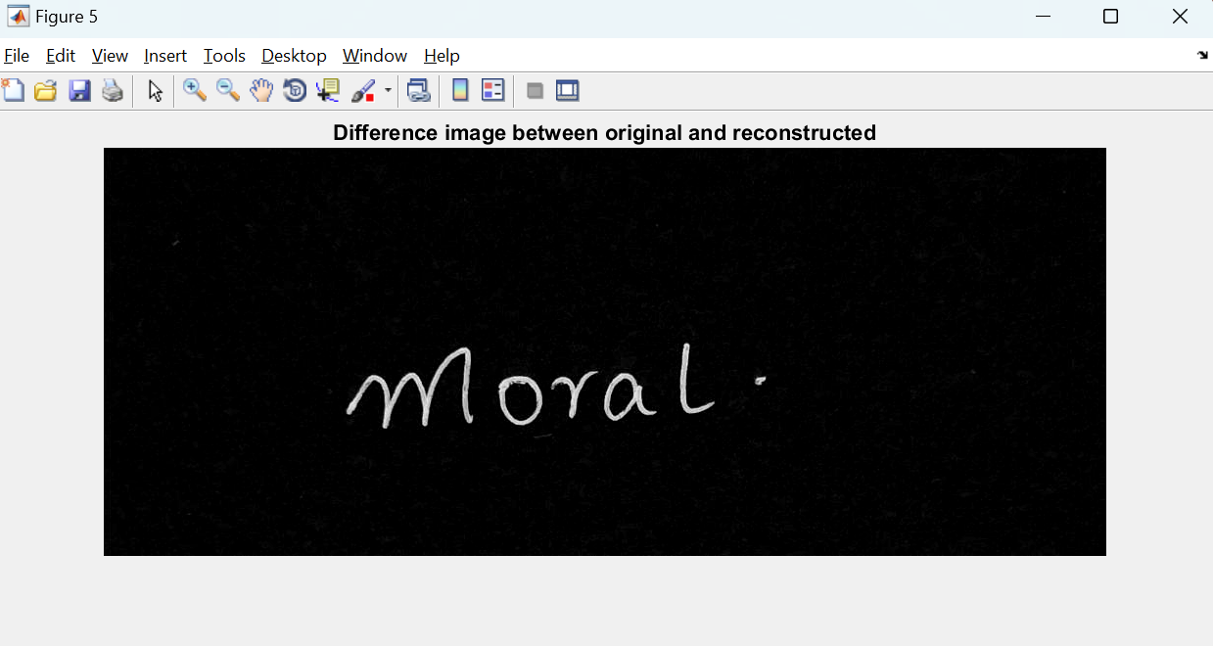
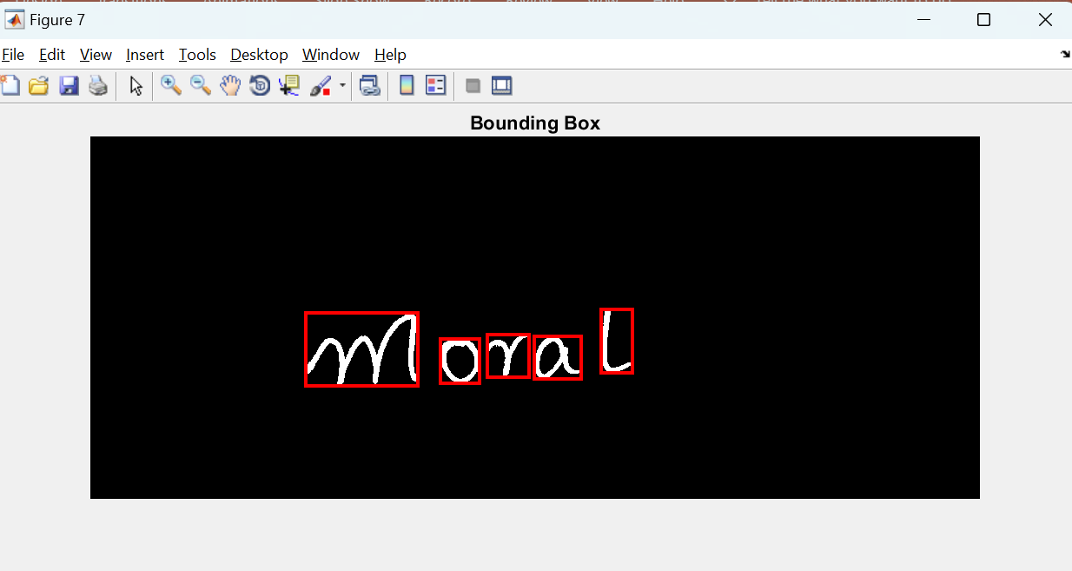

Slide 25
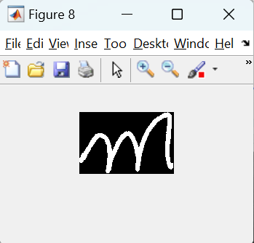
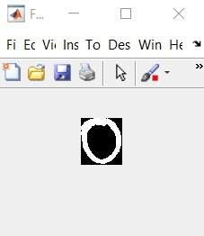
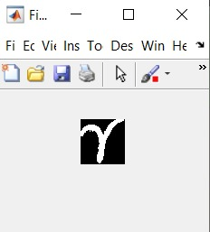
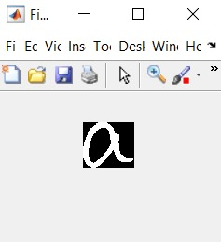


Slide 26
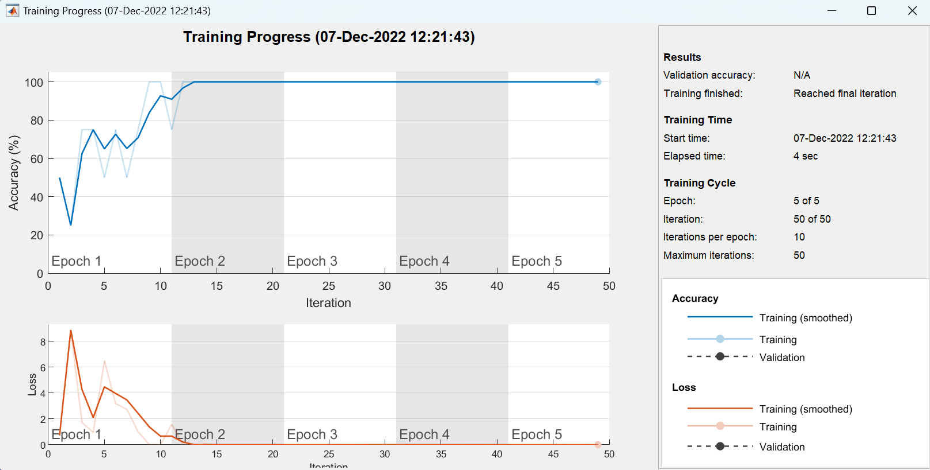

Slide 27
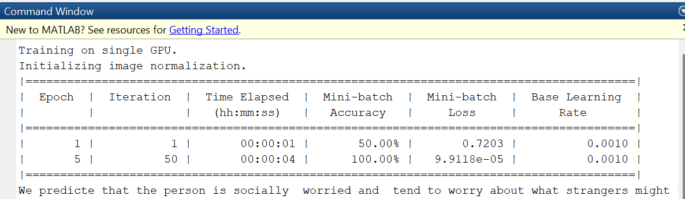

Slide 28
Work done in phase 1
IMAGE ACCUSATION.
PRE-PROCESSING.
IMPROVE MORPHOLOGY – ROI SEGMENTATION
CLASSIFICATION
PERSONALITY TRAIT DETECTION BASED ON LETTER ‘M’

Slide 29
Plan for Phase 2
INCLUDE MORE ALPHABETS FOR PERSONALITY TRAIT DETECTION
IMPLEMENTING SECURITY FEATURES ON THE MODEL

Slide 30
Conclusion
Using modern day techniques like neural networks to implement deep learning to solve basic tasks which are done with a blink of an eye by any human like text recognition is just scratching the surface of the potential behind machine learning. There are infinite possibilities and application of this technology. Traditional OCR used to work similar to biometric device. Photo sensor technology was used to gather the match points of physical attributes and then convert it into database of known types. But with the help of modern-day techniques like convolution neural networks we are able to scan and understand words with an accuracy never seen before in history. A further application of accurate text OCRs is to help the partially sighted and the blind in the absence of braille. In this research, a deep learning technique CNN is implemented for handwritten character recognition. The main focus of this work is to investigate CNN capability to recognize the characters from handwritten image dataset with a high
degree of accuracy. And also we include Finger print biometric authentication for security purpose to know the text in the image

Slide 31
References
Durga, L. and Deepu, R., 2018, September. Handwriting analysis through graphology: a review. In 2018 International Conference on Advances in Computing, Communications and Informatics (ICACCI) (pp. 1160-1166). IEEE.
Sutar, R.M. and Revankar, P.S., 2022, June. Analysis of Character Strengths from Handwriting Samples using Deep Learning. In 2022 International Conference on Computing, Communication, Security and Intelligent Systems (IC3SIS) (pp. 1-6). IEEE.
Hashemi, S., Vaseghi, B. and Torgheh, F., 2015. Graphology for Farsi handwriting using image processing techniques. IOSR Journal of Electronics and Communication Engineering (IOSR-JECE), 10(3), pp.01-07.\
Cohen, Rony, et al. "Handwriting in children with Attention Deficient Hyperactive Disorder: role of graphology." BMC pediatrics 19.1 (2019): 1-6.

Slide 32
Sen, Anamika, and Harsh Shah. "Automated handwriting analysis system using principles of graphology and image processing." 2017 International Conference on Innovations in Information, Embedded and Communication Systems (ICIIECS). IEEE, 2017.
Najla, AL-Qawasmeh, Muna Khayyat, and Ching Y. Suen. "Novel features to detect gender from handwritten documents." Pattern Recognition Letters (2022).
Chaubey, Gyanendra, and Siddhartha Kumar Arjaria. "Personality prediction through handwriting analysis using convolutional neural networks." Proceedings of International Conference on Computational Intelligence. Springer, Singapore, 2022.
Mahale, Prajakta, et al. "Handwriting Analysis Using Machine Learning." (2021).

Slide 33
THANK YOU

